Slide 1
T
TRISHNA 3D
See the home
beyond the plan.
Turn architectural drawings into interactive 3D spaces.
A browser-based architectural walkthrough studio
Problem · Proposed solution · Scalability · Sustainability
DevDay Exchange Community Hackathon · Kochi · 2026
Notes:
Introduce Trishna 3D in one sentence: it turns architectural drawings into 3D spaces people can explore. Set up the four parts of the pitch.
Source: README.md; src/components/BuildingViewer3D.tsx

Slide 2
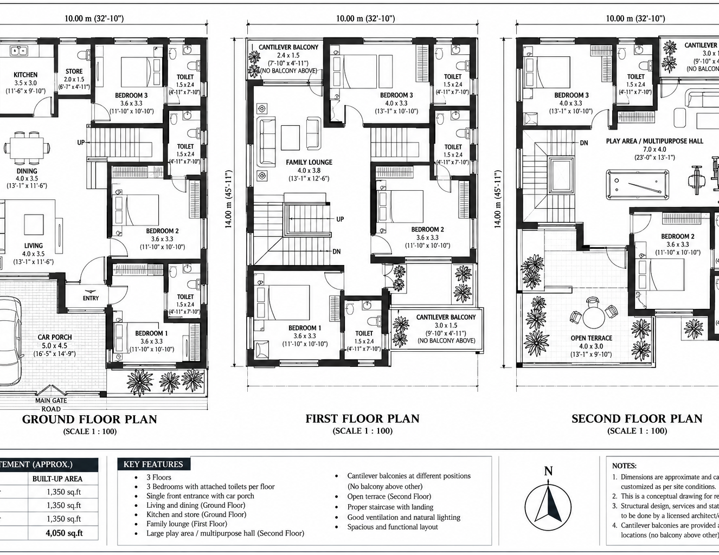
PROBLEM STATEMENT
A flat plan leaves too much
for people to imagine.
The drawing records the layout. It does not show how the finished home feels to move through.
DEPTH
Room size is hard to picture.
CIRCULATION
Stairs and floor connections stay abstract.
CONFIDENCE
Buyers and clients must mentally build the space.
A real three-floor plan · 10 m × 14 m footprint
02
Notes:
Point to the sample drawing. It describes a 10 by 14 metre, three-floor home, but its depth and circulation must still be imagined from a flat view.
Source: public/extracted.png; public/three-floor-residence-drawing.pdf; README.md

Slide 3
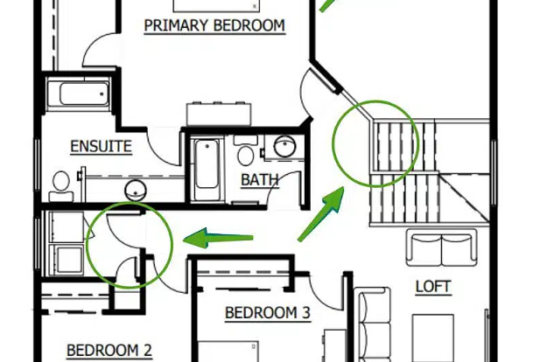
PROPOSED SOLUTION
Upload a plan. Explore a home.
A clear path from drawing to multi-storey walkthrough.
01
READ
02
RECONSTRUCT
PDF, PNG or JPG
Map the spaces
PDF.js parses plan documents in the browser.
Optional Gemini Vision helps interpret custom uploads.
03
BUILD
04
EXPLORE
Three.js assembles
Walk or orbit
Walls, floors, doors and stairs become an interactive model.
Move through rooms, climb connected floors and play the build animation.
03
Notes:
Describe the proposed solution as an end-to-end flow. PDF.js handles plan documents; Gemini is optional for live interpretation of uploads. Three.js renders the assembled model with orbit and first-person navigation.
Source: README.md; src/utils/parseFloorPlanPdf.ts; src/utils/geminiPlanAnalyzer.ts; src/components/BuildingViewer3D.tsx

Slide 4
SCALABILITY
Start with one home. Build toward more.
A working base today, with clear steps for broader use.
WORKING TODAY
Browser-based workflow
PDF, PNG and JPG inputs · three-floor sample model · local rendering
PLANNED NEXT
Broaden interoperability
DXF / IFC export is a roadmap item, not part of this prototype.
FUTURE DIRECTION
Extend the experience
WebXR headset walkthroughs are a future direction.
Scaling constraint
Custom-plan vision analysis needs a Gemini API key; complex drawings need more validation.
04
Notes:
Separate what exists from what is planned. The current prototype runs in a browser and demonstrates a three-floor sample. DXF/IFC export and WebXR are future roadmap items. Custom-plan vision analysis depends on a Gemini key, and complex drawings need more validation.
Source: README.md; SUBMISSION.md; AI_USAGE.md

Slide 5
SUSTAINABILITY
Better spatial decisions,
earlier in the process.
SUSTAINABILITY
OPPORTUNITY
A 3D walkthrough can help people discuss layout before construction.
01
REVIEW EARLY
See circulation and room relationships before a home is built.
02
WORK TOGETHER
Give clients and project teams a shared view of the proposed space.
03
RUN LOCALLY
Explore bundled models in the browser without a cloud-rendering queue.
Potential contribution, not a measured impact
This prototype does not yet calculate material, energy or carbon savings.
Notes:
Frame sustainability honestly. Earlier spatial review may help teams identify layout changes before construction, but this prototype has not measured material, energy or carbon savings. Browser-based sample rendering avoids a dedicated cloud render queue; user devices still consume energy.
Source: README.md; src/components/BuildingViewer3D.tsx; limitation disclosure authored for this pitch.

